Slide 1
Project Update 2
Alec Schneider

Slide 2
Overall Summary
Accomplishments This Past Period:
Finalized logic for NA values in columns
Cleaned up variable names
Explored distributions of variables
Explored the relationships between variables
Mapped all flight patterns in the data using geocode
Created ratios to determine how delayed a flight was or how late it was to arrive
Next Steps:
Create a function to use across multiple R scripts to clean and transform the dataset
Categorize certain numeric variables in order to prep the dataset for modeling
Decide on factoring variables
Create summary statistics for grouped variables
Begin initial linear regression modeling and use of support vector machines
What’s working well:
Sole creative vision
Plotting the variables to draw insights on how they are distributed and their relationships with other variables
Use of tidyverse for data grouping, summarization, and filtering is a productivity and code readability boost
Note taking and comments within the code are detailed and informative
Issues:
Individual work is leading to lack of constructive feedback on ideas
Categorization of numeric variables

Slide 3
Data Processing
NA Values:
For NAs in the Satisfaction column, the mean satisfaction score was imputed
The 337 rows that were not cancelled flights and had NAs, in the Arrival Delay in Minutes and Flight Time in Minutes columns were dropped form the dataset
Left the NAs in for all cancelled flights, will see how this can be leveraged later
Create variables for Departure Delay and Arrival Delay as a percent of Flight Time
Fixed column names to replace spaces with underscores
Fixed Orgin_City column name to Origin_City

Slide 4
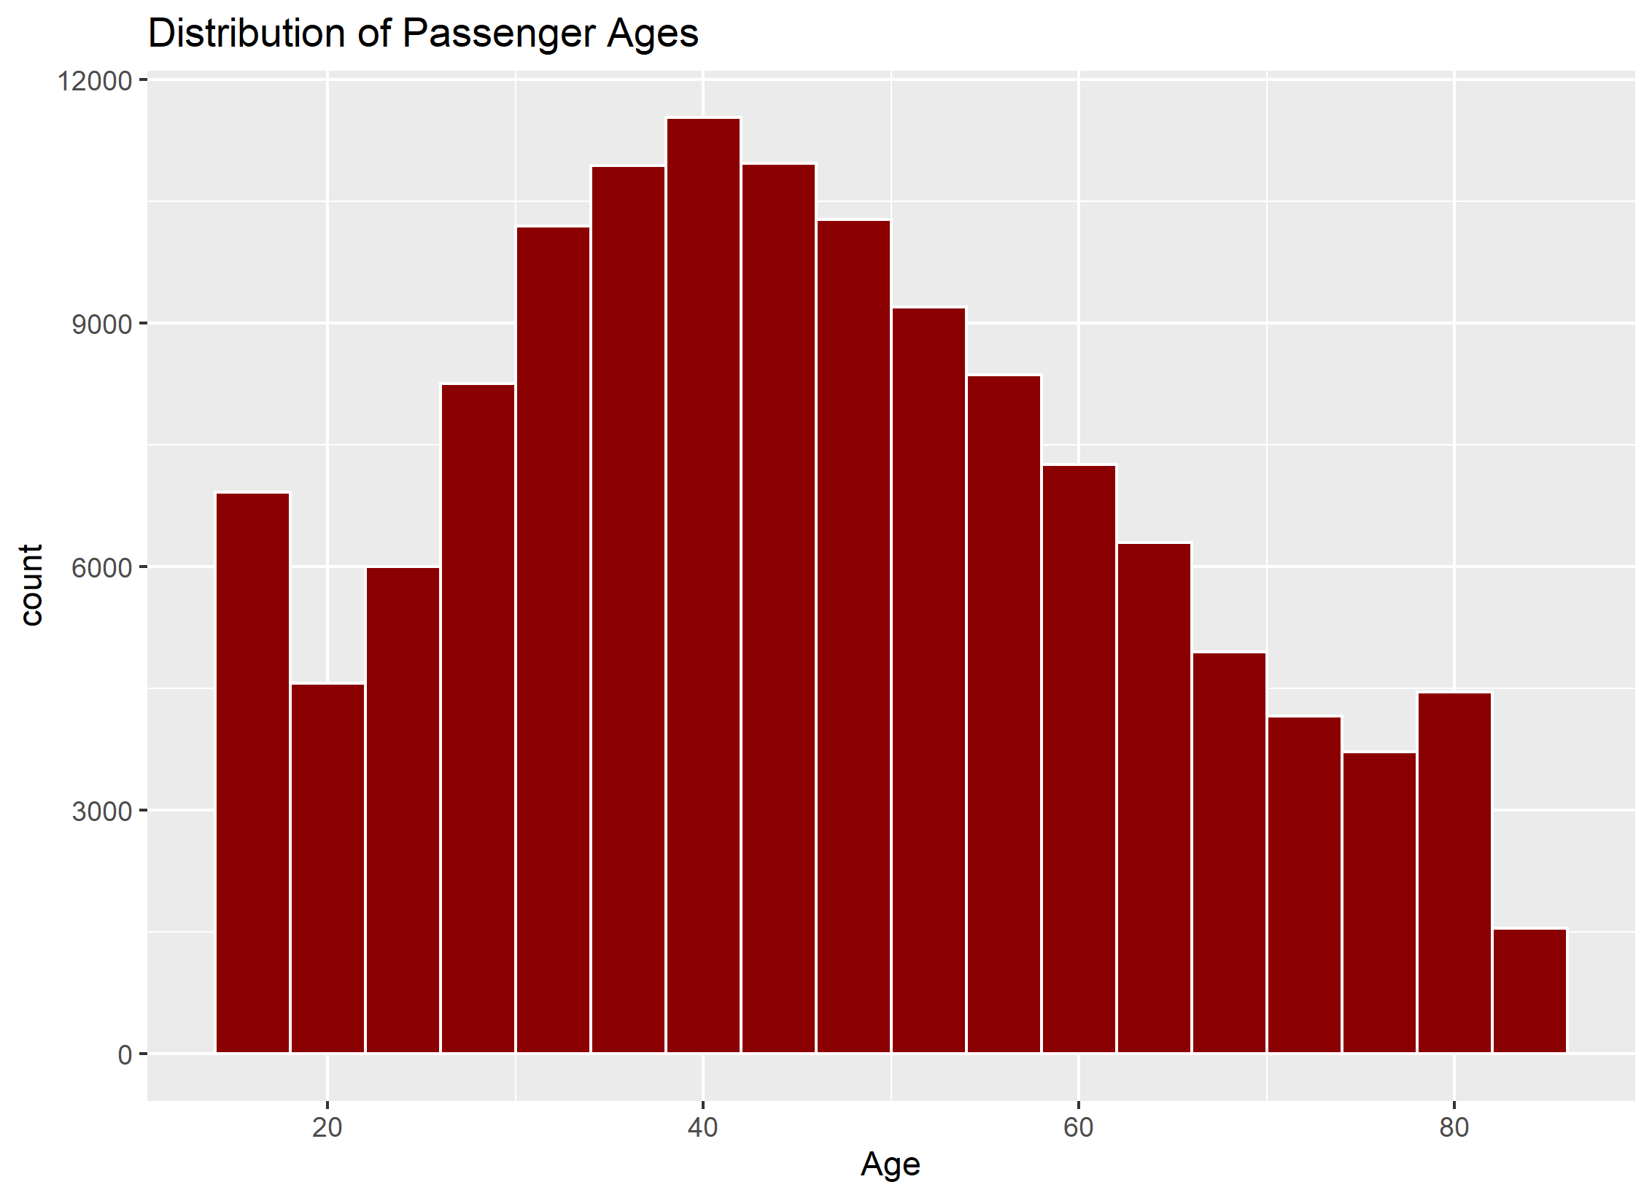
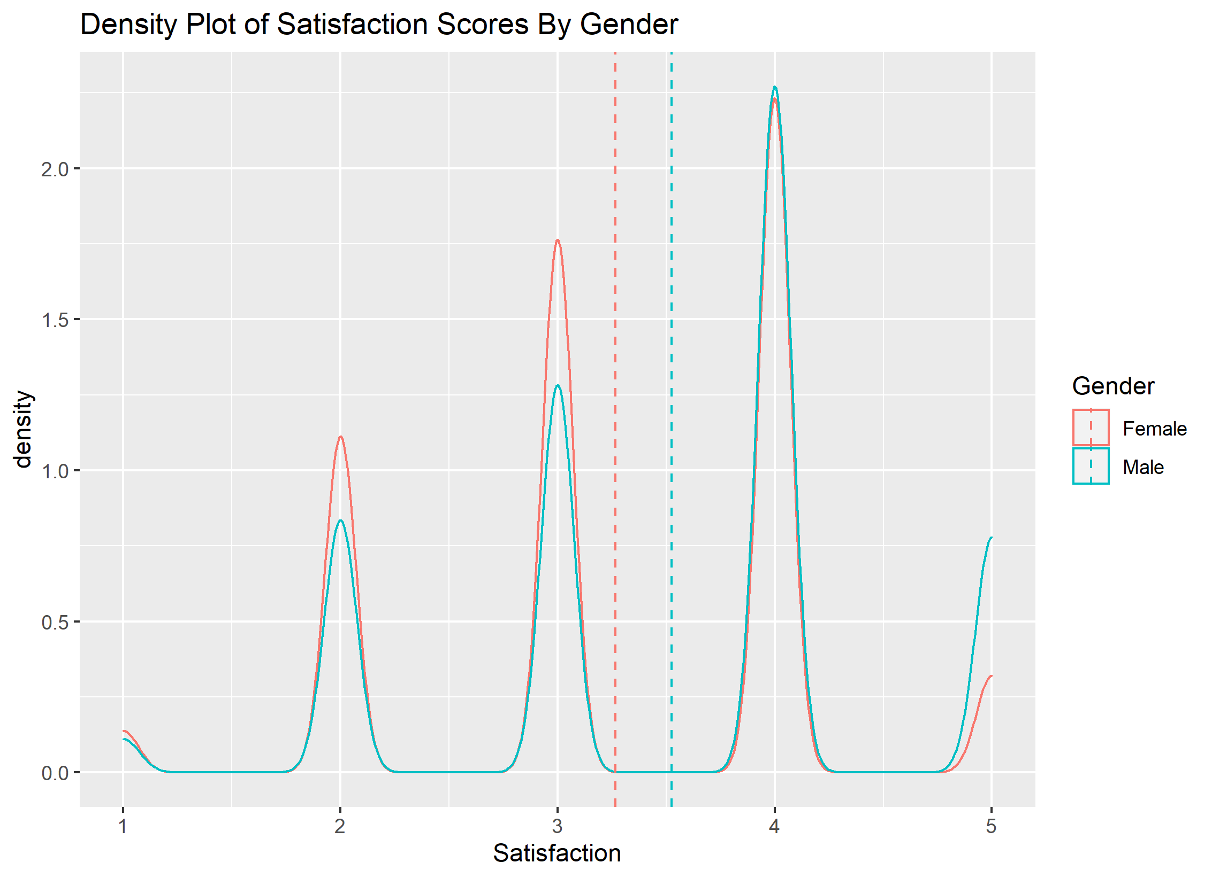
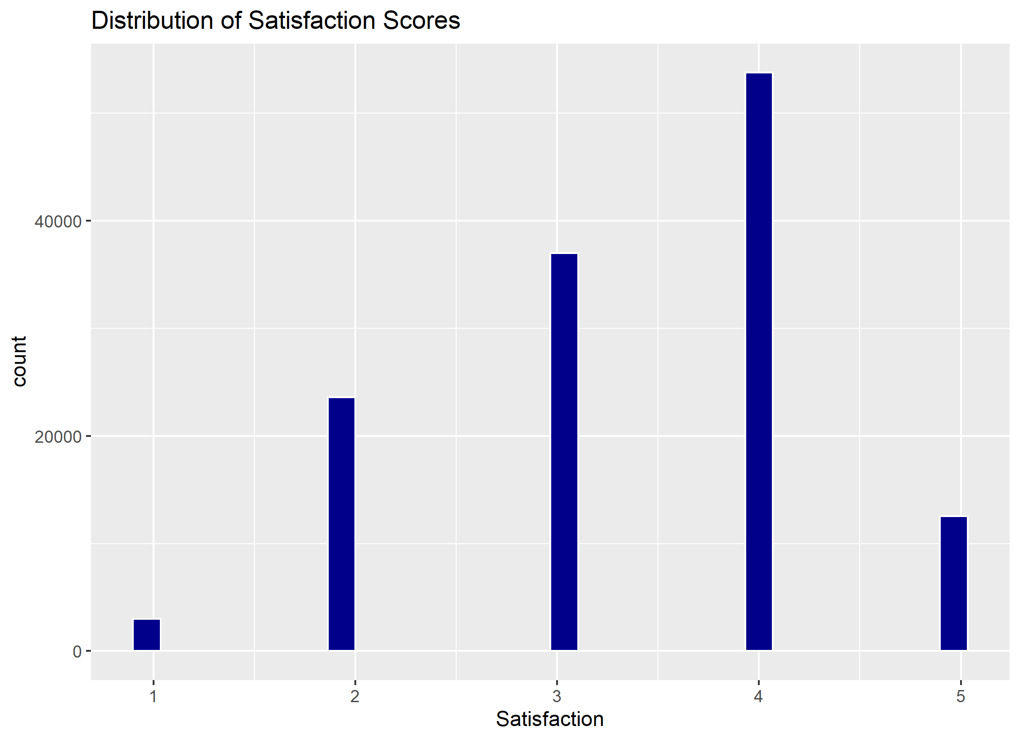
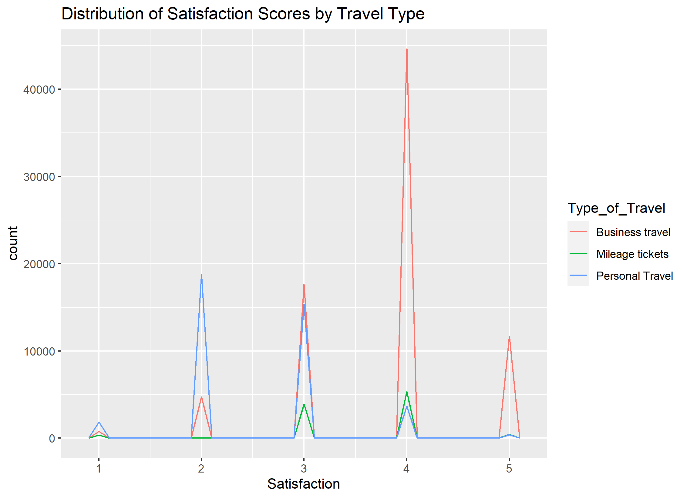
Distribution of Variables

Slide 5
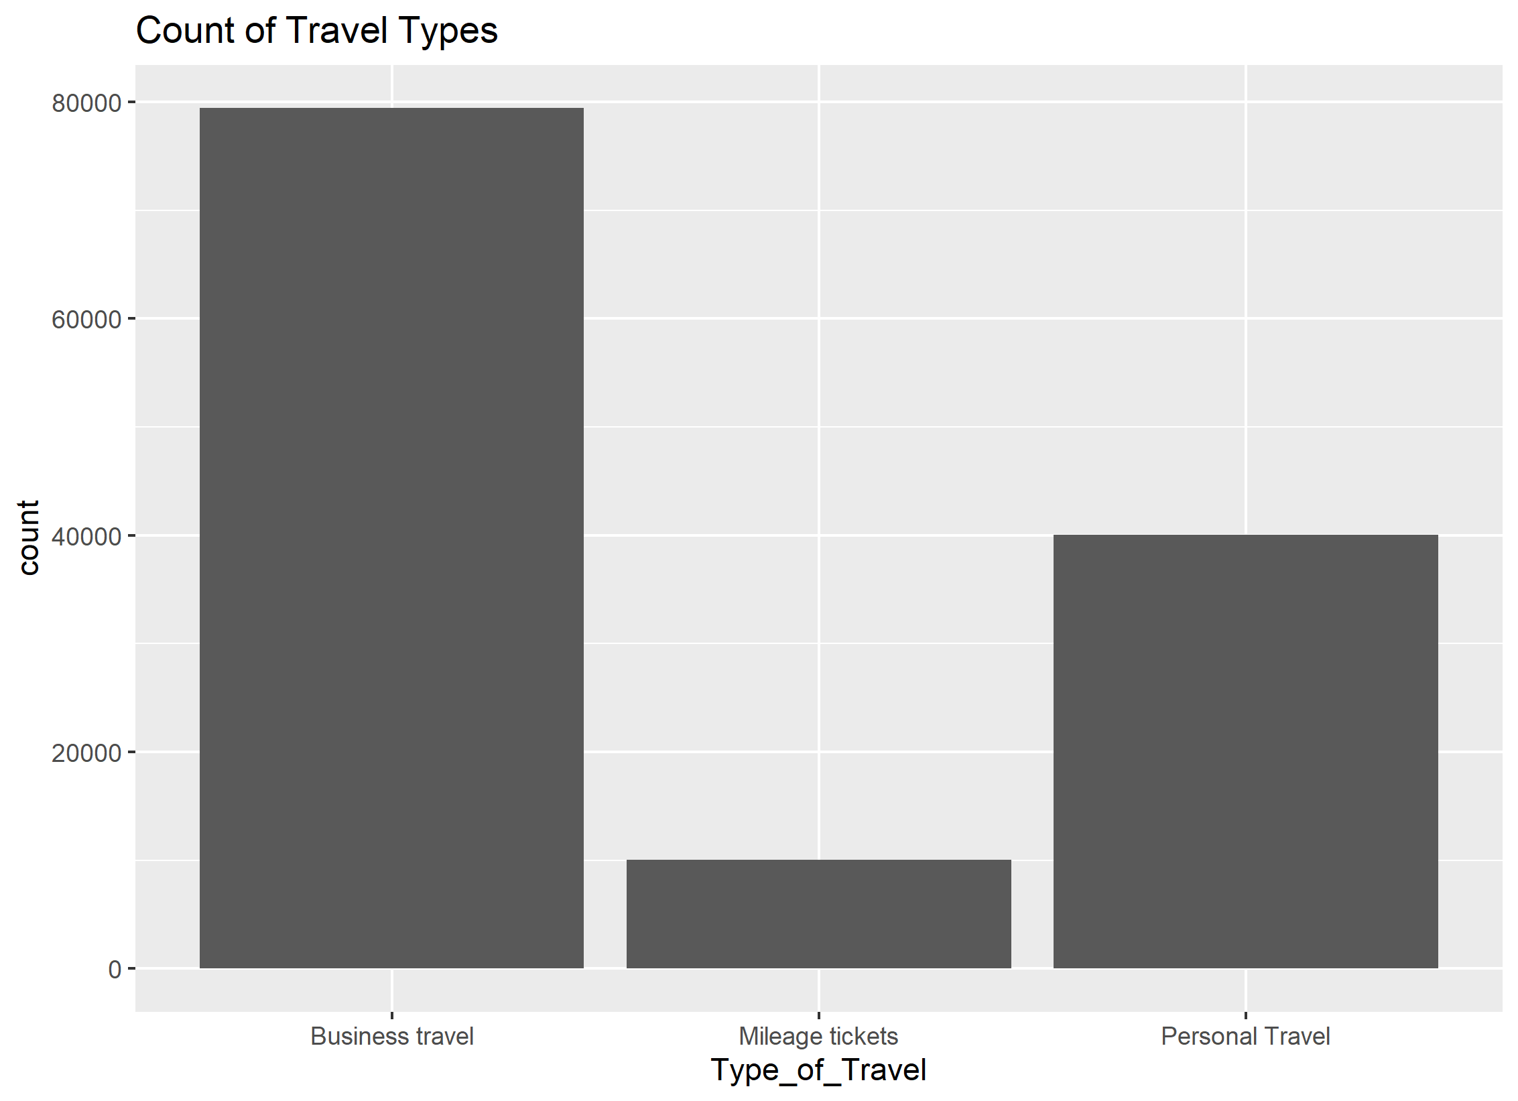
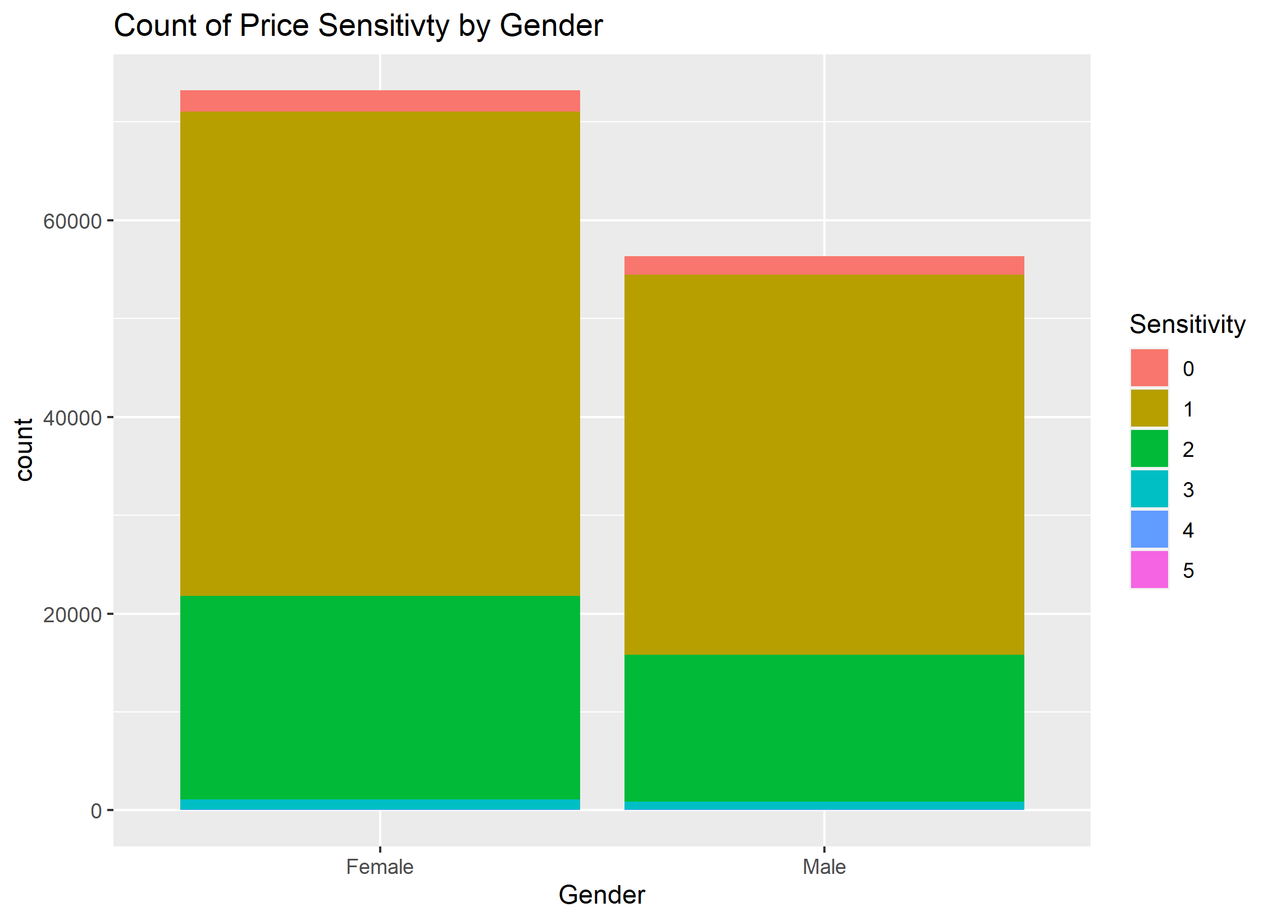
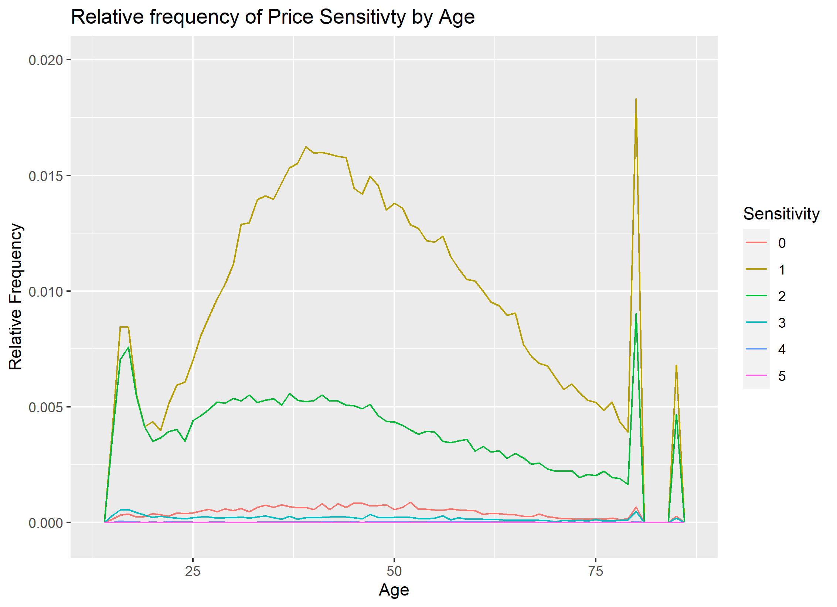
Distribution of Variables

Slide 6
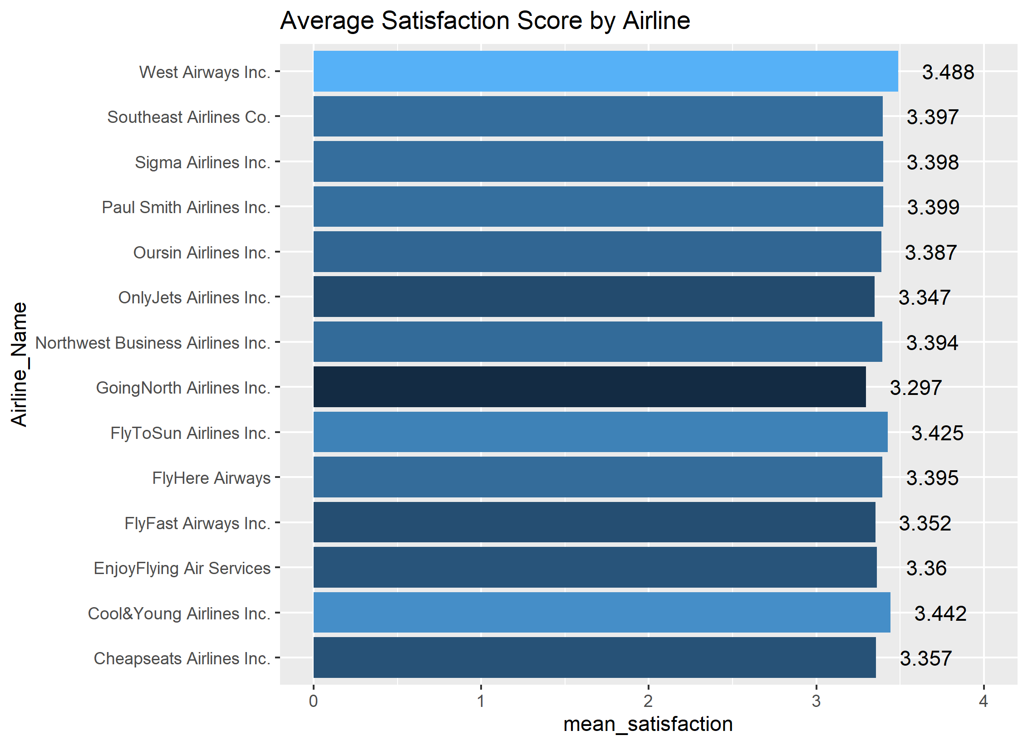
Mean Satisfaction by Airline

Slide 7
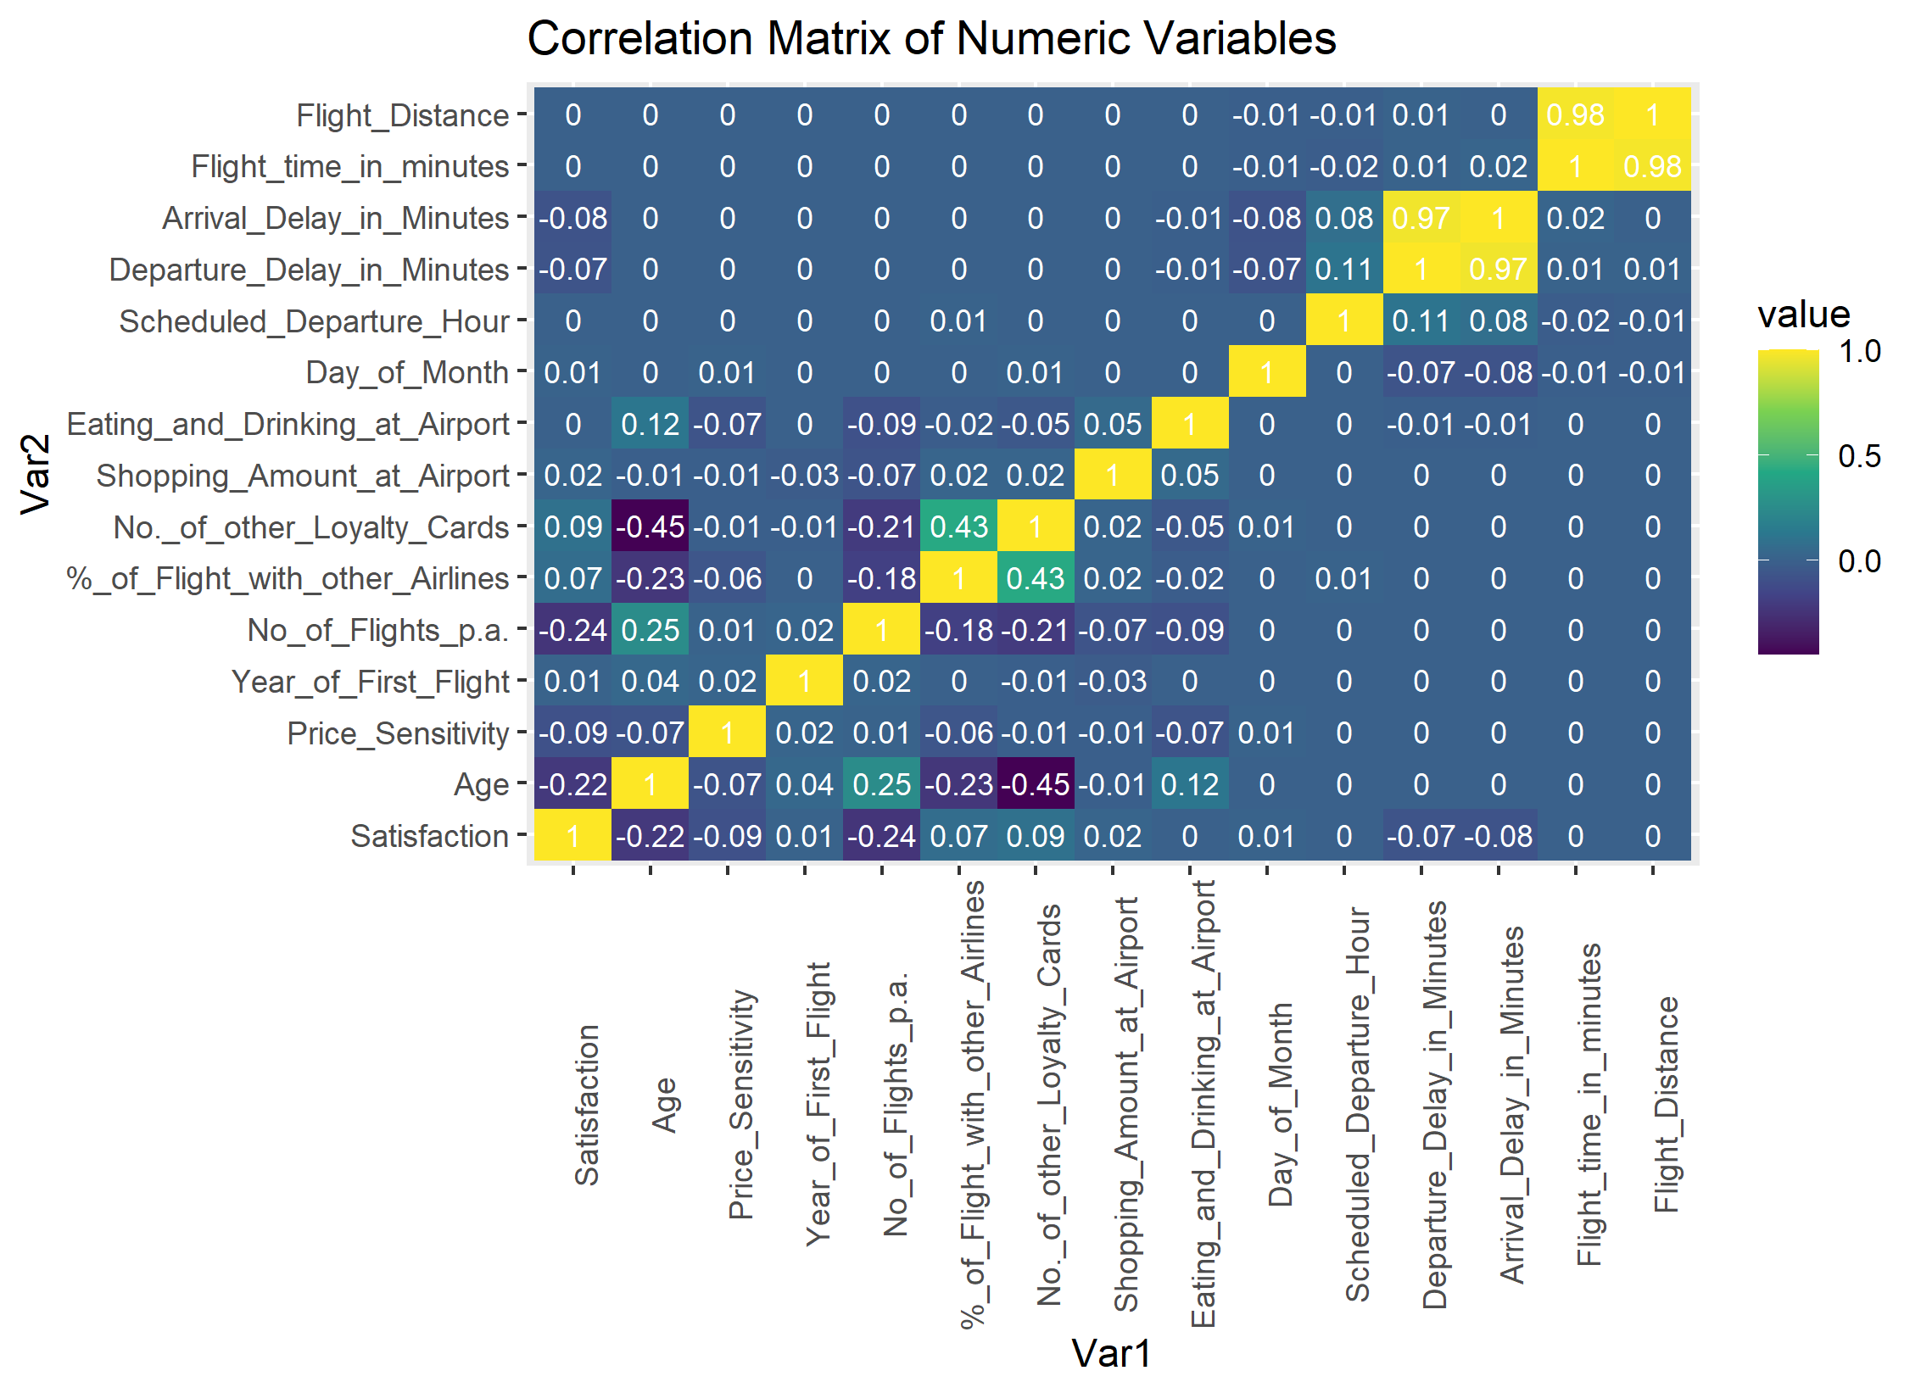
Relationships Between Variables
No strong correlations with our y variable, Satisfaction

Slide 8
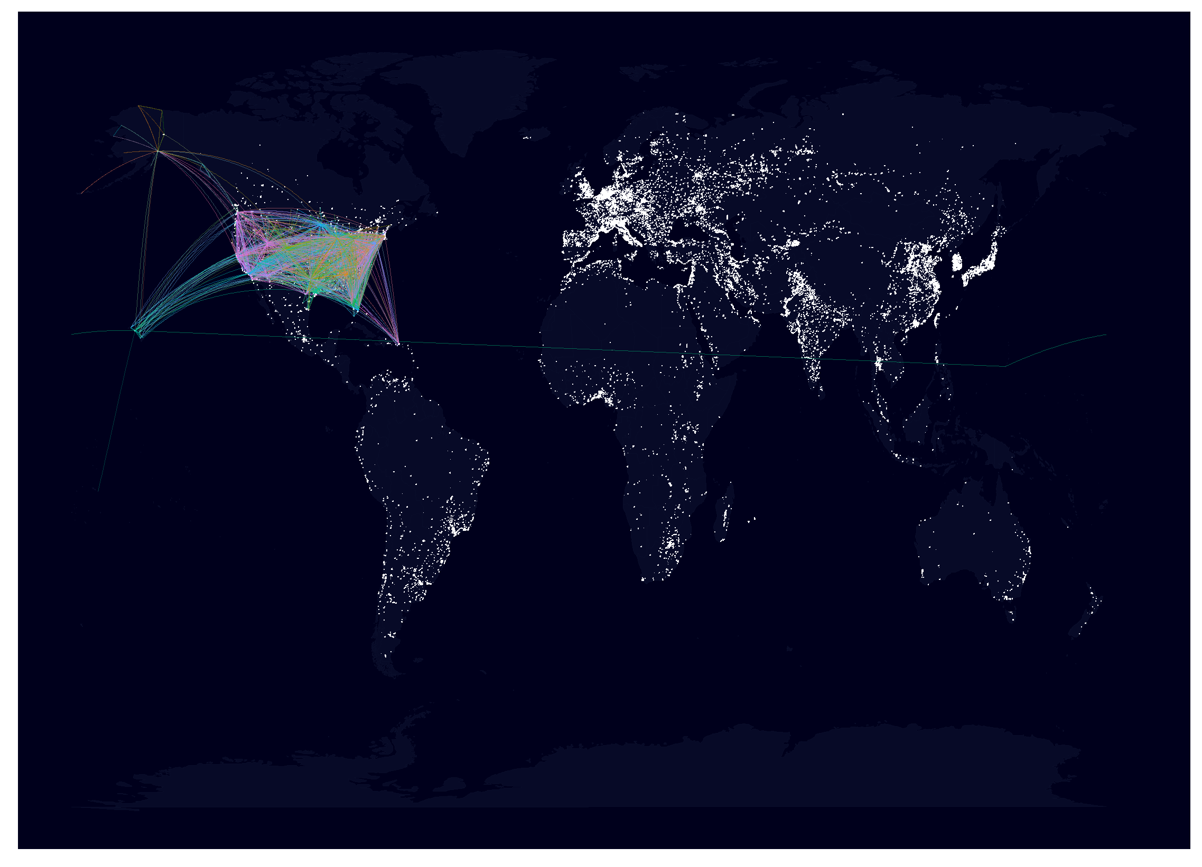
Map of Flight Routes
North America View
World View

